Slide 1
Security: Reducing Risk
Presenters:
Ron Wozny
Healthx, Inc.
Vice President of Marketing
rwozny@healthx.com
Scott McPheeters
Healthx, Inc.
Chief Security Officer
smcpheeters@healthx.com

Slide 2






Healthcare Data Breach Headlines
Healthcare No. 1 target for cyberattacks in 2015…
More than 100 million healthcare records were compromised last year.
2016: The Year of Data Security
2015 health plan data breach cost $17.3M
Rising Cyber Attacks Costing Health System $6 Billion Annually
Report: Cost of breach could cross $100M

Slide 3
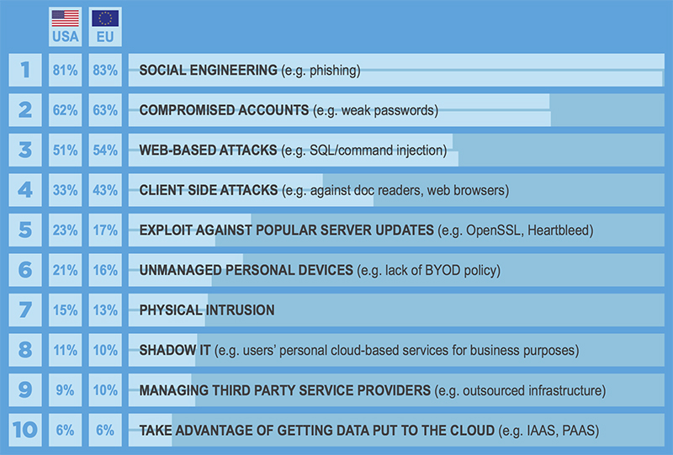
Top Security Risks

Slide 4

Top Security Risks

Slide 5

Top Security Risks

Slide 6

Top Security Risks

Slide 7



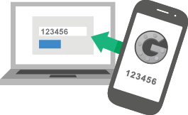
Mitigating Security Risks
Security roadmap and executive team that meets regularly, including CFO
Always Phishing
Two-factor authentication everywhere
Frequent penetration testing

Slide 8
Security: Reducing Risk
Presenters:
Ron Wozny
Healthx, Inc.
Vice President of Marketing
rwozny@healthx.com
Scott McPheeters
Healthx, Inc.
Chief Security Officer
smcpheeters@healthx.com

