Slide 1
Electronic Healthcare Delivery: Telemedicine’s Time Has Come
Presented by: Todd Heiserman, Teledoc Area VP, TPA Sales
Doug Wilcox – Healthx Director of Marketing

Slide 2
Telemedicine’s Time Has Come
80% of adults discharged from ER were there due to lack of access to other provider
Family practice wait time is currently 19 days
PCP visits are projected to increase 40% over the next 10 yrs, while the number of primary care physicians is currently facing a shortage
Shift in aging population

Slide 3
Convenient, Affordable Access to Quality Care

Slide 4
Telemedicine Drivers
Consumers
Provide 24x7, on-demand access via phone, mobile, and video
Providers/TPAs
Prevent unnecessary ER/UC visits to more cost effective mode of care
Employers
57% of companies plan to adopt telemedicine

Slide 5
Thought Leadership & Innovation Series
Market Dynamics and Teladoc Solutions

Slide 6
Market Dynamics
WHAT’S HAPPENING AND WHAT’S NEXT?

Slide 7
The size of the opportunity
Ambulatory Care market
Behavioral Health market
1.25b billion ambulatory care visits¹
168m. million annual addressable visits
33% estimated treatable through telehealth
78% estimated treatable through telehealth
71% of employer sponsored ER visits are unnecessary
417million
potential visits
131million
potential visits
1. Source: CDC, AHRQ, Forbes “ The Future of Health Ecosystem” 2/3/2016
Notes:
71% data Source is Truveen Analytics Survey published in Becker's-link below.
derivative of CDC and AHRQ data as shown on slide.
http://www.beckershospitalreview.com/patient-flow/study-71-of-ed-visits-unnecessary-avoidable.html

Slide 8
The size of the opportunity
Ambulatory Care market
Behavioral Health market
1.25b billion ambulatory care visits¹
168m. million annual addressable visits
33% estimated treatable through telehealth
78% estimated treatable through telehealth
71% of employer sponsored ER visits are unnecessary
417million
potential visits
131million
potential visits
1. Source: CDC, AHRQ, Forbes “ The Future of Health Ecosystem” 2/3/2016
Notes:
71% data Source is Truveen Analytics Survey published in Becker's-link below.
derivative of CDC and AHRQ data as shown on slide.
http://www.beckershospitalreview.com/patient-flow/study-71-of-ed-visits-unnecessary-avoidable.html

Slide 9
Potential impact for employers
Consumers are open to virtual care…
54% | 18-29 year olds
49% | $71,000+ income
53% | Work 35+ hours
…and employers are embracing it.
48% currently offer telehealth services
74% plan to offer telehealth in the next year
Source: Forbes “ The Future of Health Ecosystem” 2/3/2016
Notes:
Forbes The Future of Health Ecosystem 2/3/206 data source.
http://www.forbes.com/sites/davechase/2016/02/03/report-the-future-health-ecosystem-today-provides-look-into-healthcares-future/#4a094c671b65

Slide 10
Telehealth provider landscape
# of visits
Share
Mode of visit
Monetization
Doc network
575k+
~70%
Choice of video or phone
Access fee (“PEPM”)
3,100 MD, BH, Derm professionals
125k – 150k
~15%
Choice of video or phone
Access fee (“PEPM”) or license fee
2,300 MD, BH professionals
60k – 80k
~10%
Video only
License or other fee
MD, BH and dieticians
<50k
~5%
Video only
Visit fee only
1,500 MD, Psych, and other

Slide 11
About Teladoc
HOW WE FIT IN THE MARKET

Slide 12
What we do
24/7/365 ACCESS
Provide 24/7, on-demand access to board-certified providers via video, phone or mobile app
TREAT HEALTH ISSUES
Diagnose, treat and prescribe medications (if necessary) for common health issues
NEW PRODUCTS
Behavioral Health, Dermatology and Tobacco Cessation available
PROVEN ROI
Prevent unnecessary ER/UC visits to more cost-effective mode of care

Slide 13
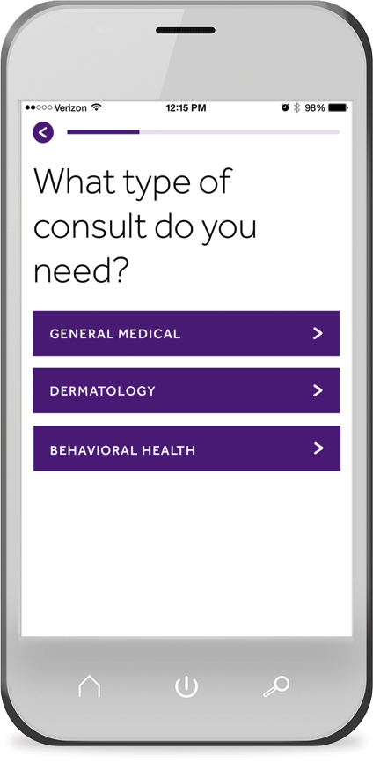
Sustained growth
900,000
Teladoc has grown from 1,000 consults in 2005 to a projected 900,000 visits in 2016. We delivered our one millionth visit in October, 2015
EST.
2005
2006
2007
2008
2009
2010
2011
2012
2013
2014
2015
2016

Slide 14
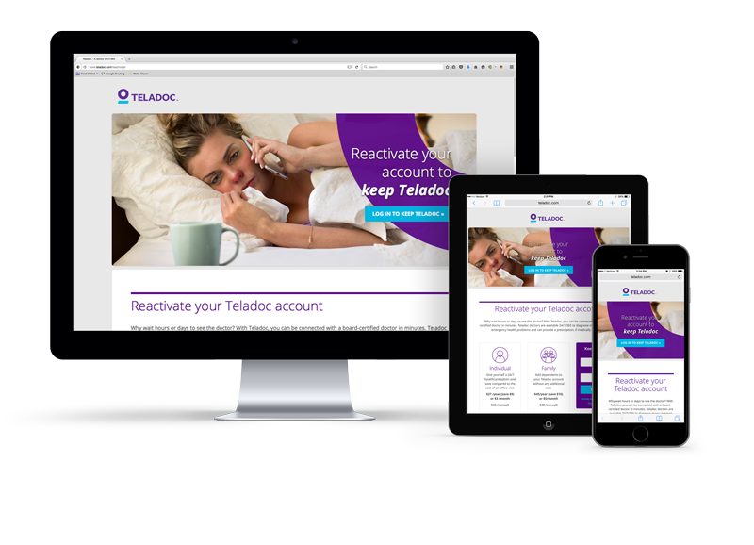
An innovative and scalable technology platform
CUSTOMIZABLE
Custom branded pages
PURPOSE BUILT
Easy-to-use member experience
FULLY INTEGRATED
Real-time eligibility
HIGHLY SCALABLE
Over 2,000 visits/day
12.9M members
SECURE & RELIABLE
3rd party tested and validated

Slide 15
Marketing that drives utilization
DIRECT MAILER
EMAIL
PROMOTIONAL
Notes:
These and many more communication tools are available at our clients finger tips to help drive utilization

Slide 16
We are a Multi-Product Company
Comprehensive product portfolio serves key healthcare stakeholders
General Medical
Pediatrics
Behavioral and Mental Health
Dermatology
Tobacco Cessation
Sexual Health
Health Plans
Employers
Health Systems
& Hospitals
Consumers

Slide 17
Thank You

Slide 18
How Do I Get Electronic Healthcare Delivery?
If you would like more information on implementing the Electronic Healthcare Delivery within your Healthx platform, reach out to your account manager to request a demo.
Or contact us at info@healthx.com.
See our blog @ www.healthx.com

Slide 19
Electronic Healthcare Delivery: Telemedicine’s Time Has Come
Presented by: Todd Heiserman, Teledoc Area VP, TPA Sales
Doug Wilcox – Healthx Director of Marketing

